Slide 1
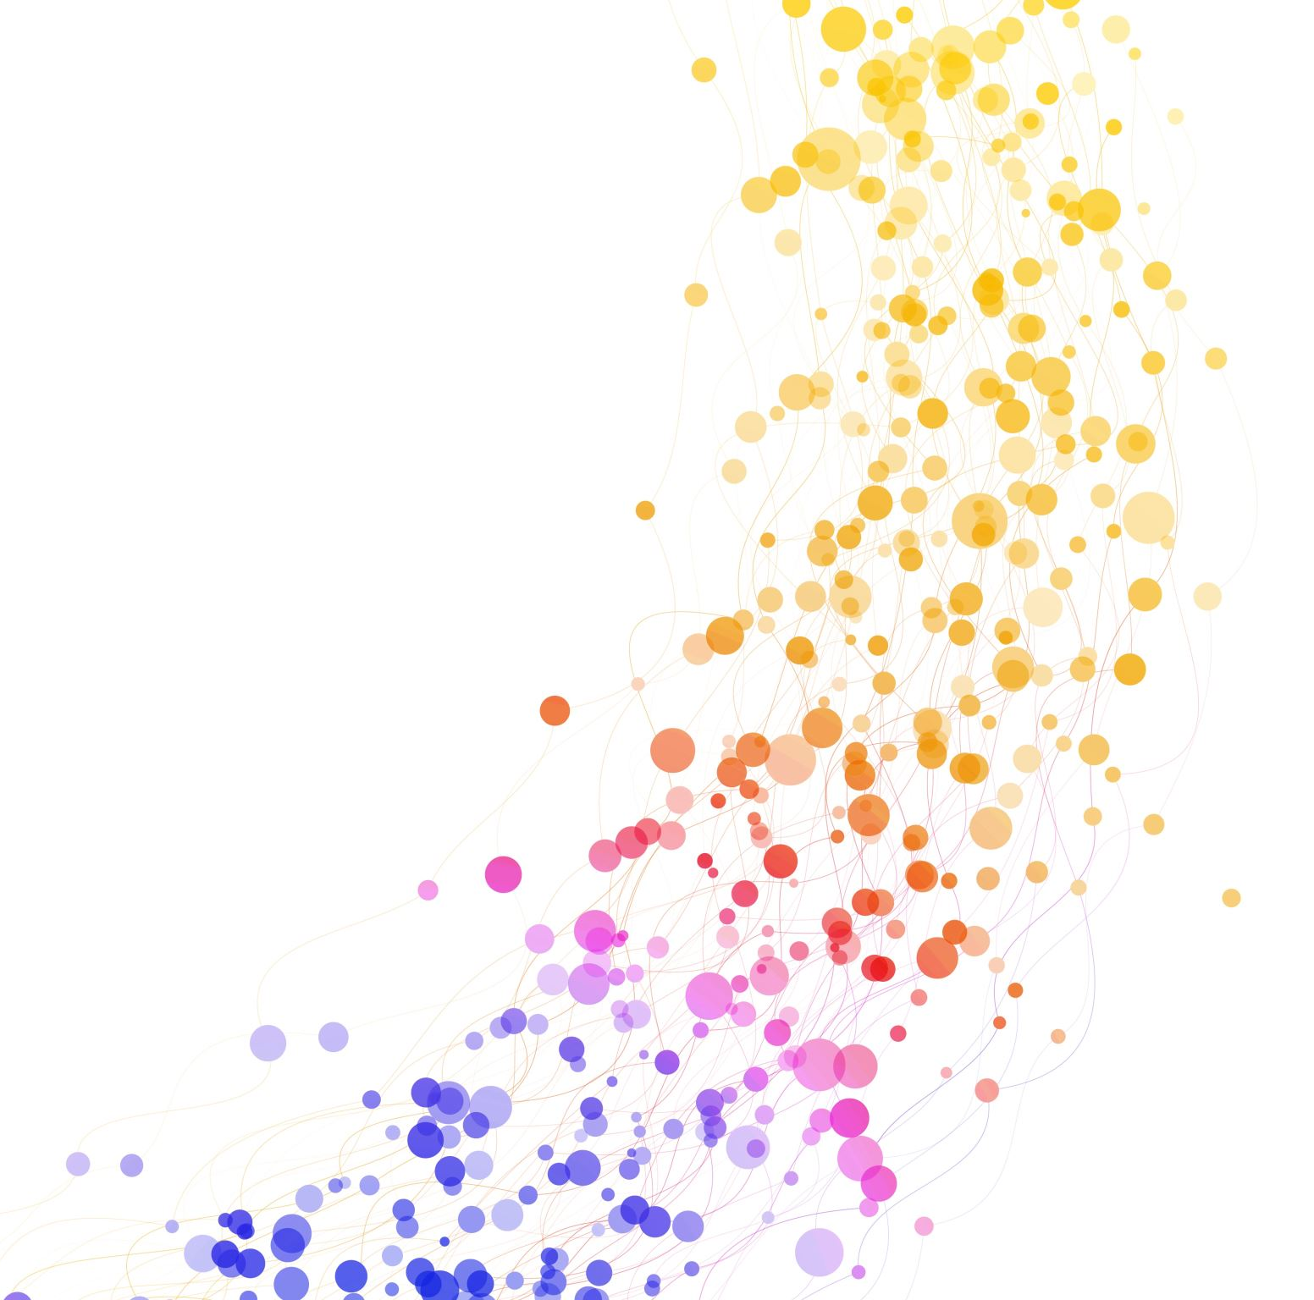
Simplifying Multi Cloud Observability
Siri Varma Vegiraju

Slide 2

Siri Varma Vegiraju
Software Engineer
Freelance Contributor
Book Reviewer
LinkedIn: /sirivarma
Email: siri.varma@outlook.com
Twitter:

Slide 3
Agenda
What is Multi Cloud and why it is gaining popularity
1
What is Observability
2
Why the Approach to Observability must change for Single and Multi-Cloud Environments
3
How can we simplify Multi Cloud observability
4
Conclusion
5

Slide 4
What is Multi Cloud and why it is gaining popularity
Multi-cloud refers to using multiple cloud services from different providers within a single architecture
98% of enterprises use or plan to use multi cloud.
Motivations ?
Data Sovereignty
Cloud Vendor lock-in concerns
Cost Optimization
Notes:
Different countries have their own GDPR laws
For eg: EU states personal data should not be sent outside of EU unless the provider sates they have a strong protection
When companies have to abide by the, and i

Slide 5
What is Observability
The ability to measure the current state of the system.
Three Pillars: Metrics, Logs and Traces.
Notes:
It's about understanding what’s happening inside your systems

Slide 6
Metrics, Logs and Traces
Metrics are numerical measurements of system performance and behavior, such as CPU usage, response time, or error rate.
Logs are the archival or historical records of system events and errors, which can be plain text, binary, or structured with metadata.
Traces are the representations of individual requests or transactions that flow through a system, which can help identify bottlenecks, dependencies, and root causes of issues.

Slide 7
Why the Approach to Observability must change for Single and Multi-Cloud Environments

Slide 8
Some Stats
The average multicloud environment spans 15 different platforms and services.
On average, organizations use 9 different observability or monitoring tools to manage applications, infrastructure, and user experience

Slide 9
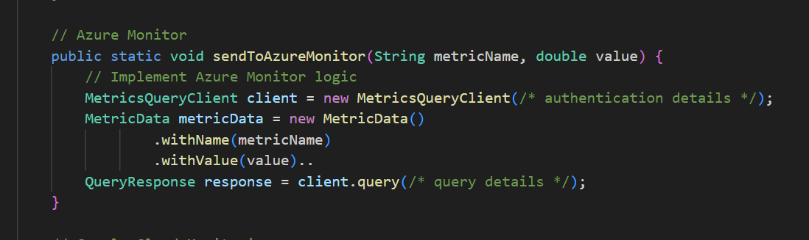
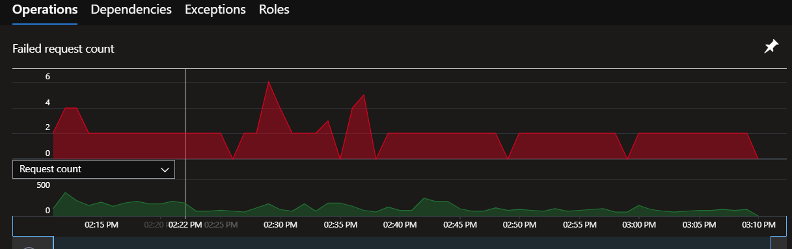
Single Cloud World
Emit Metric
Cloud Provider dashboard

Slide 10
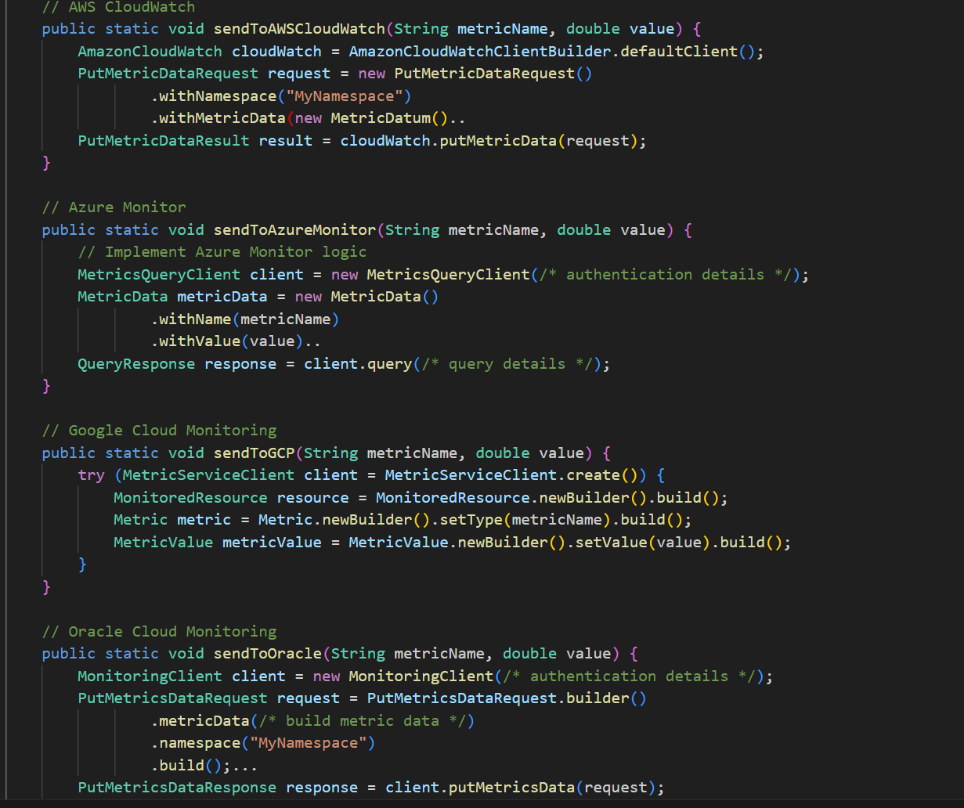
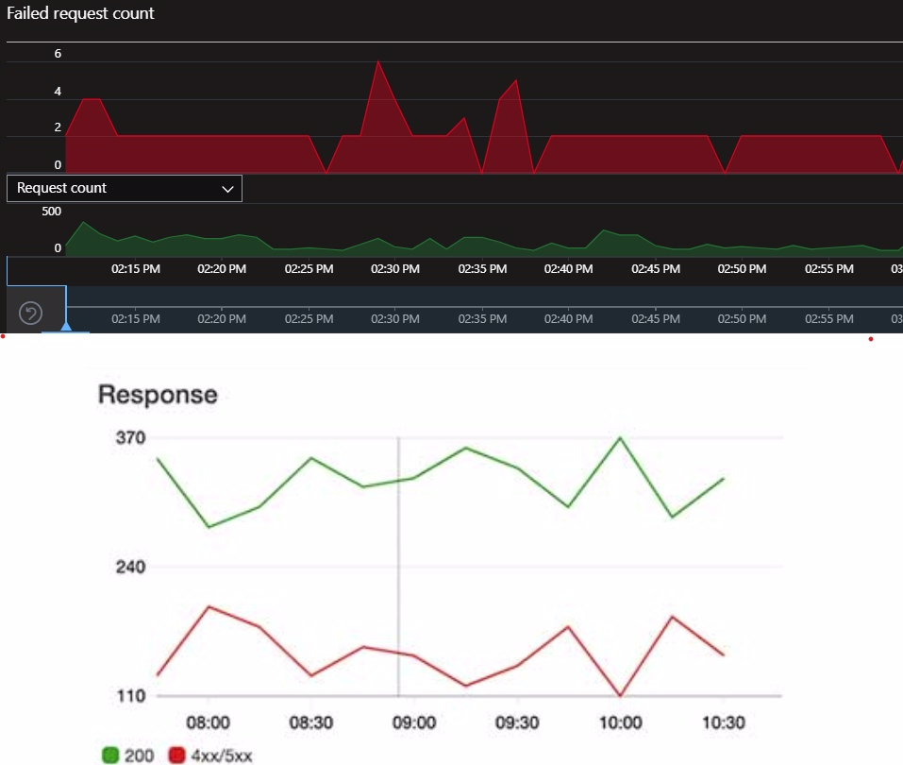
Multi Cloud World
Multiple SDKs
Multiple Provider Dashboards

Slide 11
Ton of Complexity
Not having a unified experience.
Maintaining different SDKs.
Understanding various cloud providers Observability implementations.
Diagnosing issues across multiple cloud environments can be more challenging.
Tracking observability costs across multiple clouds can be complex.
Training and Skills
Notes:
SDKS and programming languages

Slide 12
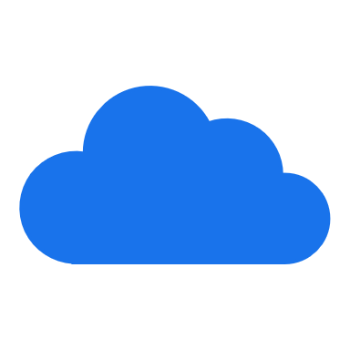
How can we simplify Multi cloud Observability ?

Slide 13
What to do we need ?
Unified Experience
Emit Metrics, Logs and Traces
Maintaining dashboards
Vendor agnostic.

Slide 14
Cloud Native Open Telemetry
Provides single open-source standard to export Metrics, Logs and Traces
Major cloud providers like AWS, Azure, GCP and Oracle support this CNCF project.
Vendor agnostic.

Slide 15
Components in Open Telemetry
Specification
Semantics
Open Telemetry SDK – Go, C#, Java
Exporter
Azure Monitor, AWS, Google Cloud, Data Dog, Zepkin, Prometheus and many more
Backend
Jaeger, AWS, Azure, Google Cloud and many more.

Slide 16
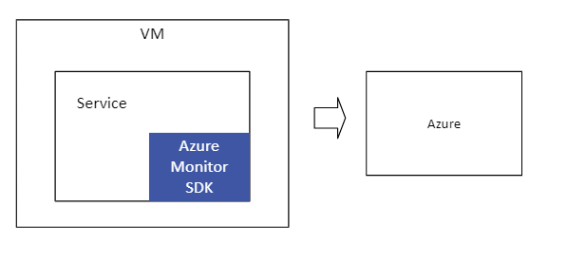
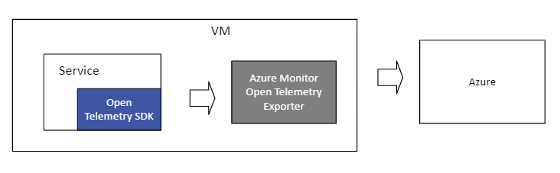
How does Open Telemetry work ?
Before Open Telemetry
After Open Telemetry

Slide 17
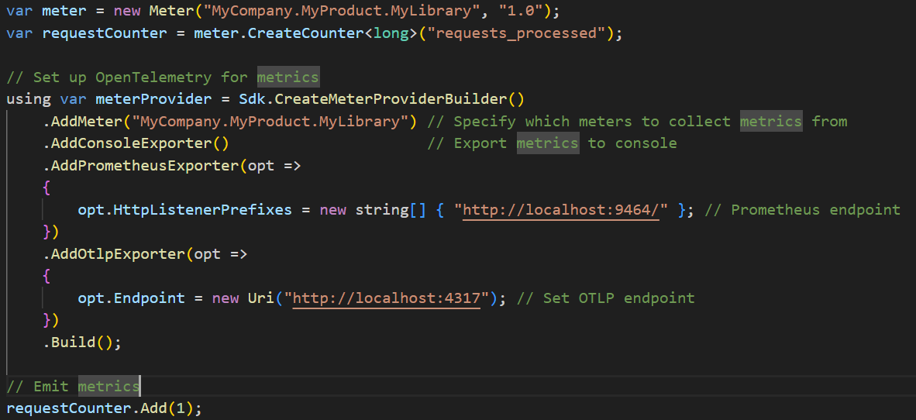

Slide 18
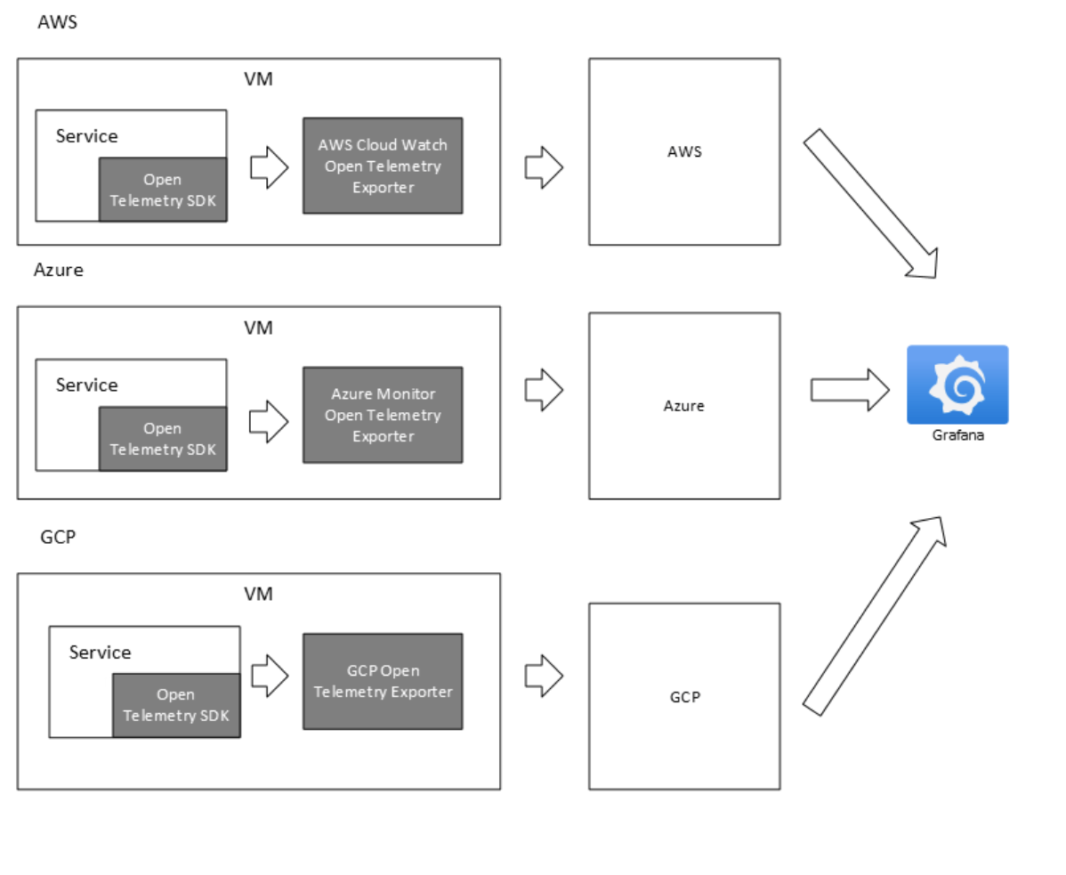

Slide 19
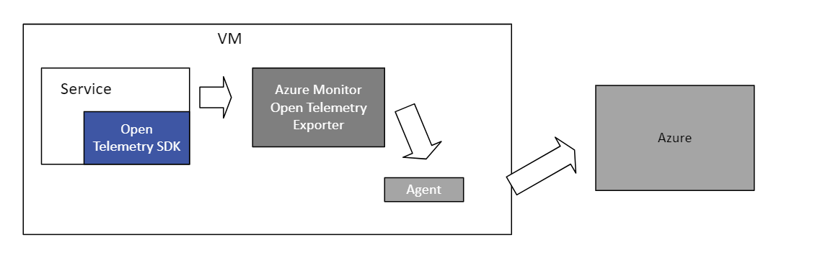
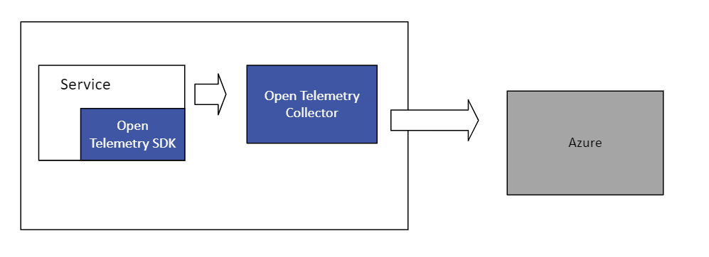
Other Architectures
Agent Arch
Collector Arch

Slide 20
Conclusion
Vendor agnostic
Other Open-source tooling
Prometheus
Loki
Zepkin

Slide 21

Thank you

